Slide 1
Java/J2EE Session- 14
Creating our first web application.

Slide 2
Contents.
Creating our first Web Application
Writing our first servlet.
explaining the contents of web.xml file
Request and Response objects.
Explaining the PrintWriter Class
Example to write the response back to the user.

Slide 3
Creating our first Web Application
Please refer to the below projects for examples on our first Web Application

Slide 4
Creating our first Web Application
Create Servlet.
  Create a simple Java Class.
  Use the extends keyword to extend HTTPServlet class.
  If we extend the HTTPServlet class then our class will not become a Servlet.
  We need to override doPost() and doGet() in the servlet class.
  If require we can also override the init() method also.
  We need to add the entries for Servlet and Servlet mapping tags in web.xml file as show in next slide.

Slide 5
Creating our first Web Application
<servlet>
<servlet-name>ServletOne</servlet-name>
<servlet-class>ServletOne</servlet-class>
</servlet>
<servlet-mapping>
<servlet-name>ServletOne</servlet-name>
<url-pattern>/ServletOne</url-pattern>
</servlet-mapping>

Slide 6
Creating our first Web Application
How to run the servlet that we have created ?
  As we have created the project with the name called as Session14Web
  That would be our context path to run our web application.
  As we have to run of first servlet called as ServletOne we need to check the URL pattern for that servlet.
  The URL pattern for this servlet that we have given is /ServletOne
So, finally our URL would be looking something like this
  http://localhost:8080/Session14Web/ServletOne

Slide 7
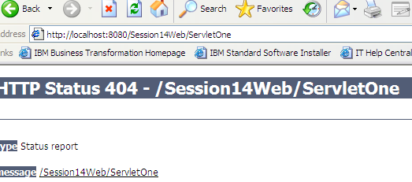
Creating our first Web Application
If we execute the above URL we will get an error called “404 Not found” as shown below

Slide 8
Creating our first Web Application
This is because we have not deployed our application to the TOMCAT Web Server.
Steps to deploy the application to the Server.

Slide 9
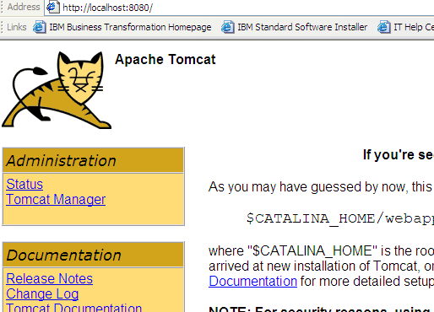
Creating our first Web Application
Click on Tomcat Manager and give the username and password.

Slide 10
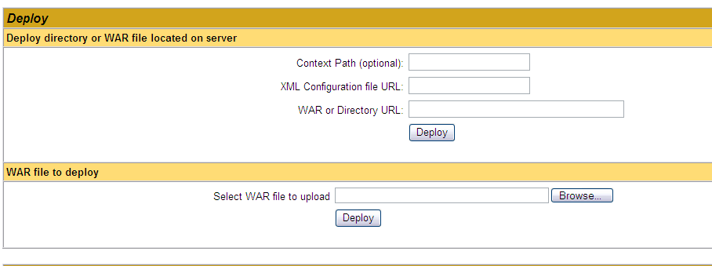
Creating our first Web Application
Scroll down the page and go to the section where we deploy the EAR
Click on Browse button and give the below path.

Slide 11
Creating our first Web Application
C:\Kiran\Personal\Tutor\Java\samples\Session14Web\dist
This is the path that I have given when I am creating the project.
In the above folder we can find the .war file that can be used to deploy the ear
Select the WAR file and say Open
Click on Deploy button. Then the EAR will be deployed.
You can see the deployed URL in the List of applications.
Now give the URL that we have created and will give the output.

Slide 12
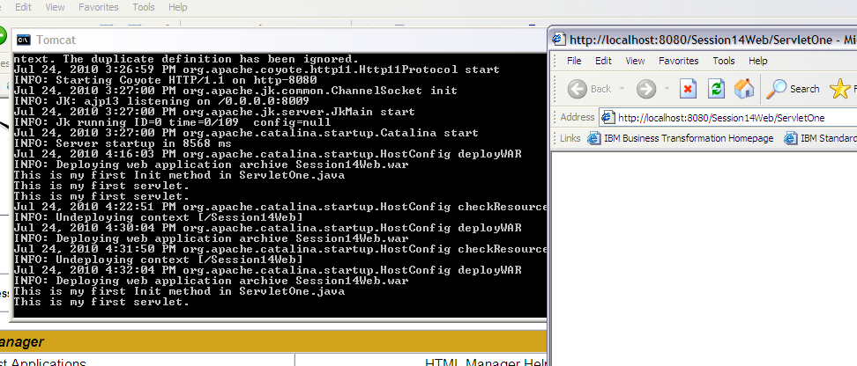
Creating our first Web Application
We can see the print statements in the console.

Slide 13
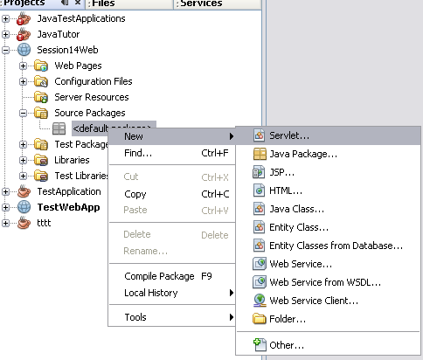
Creating our first Web Application

Slide 14
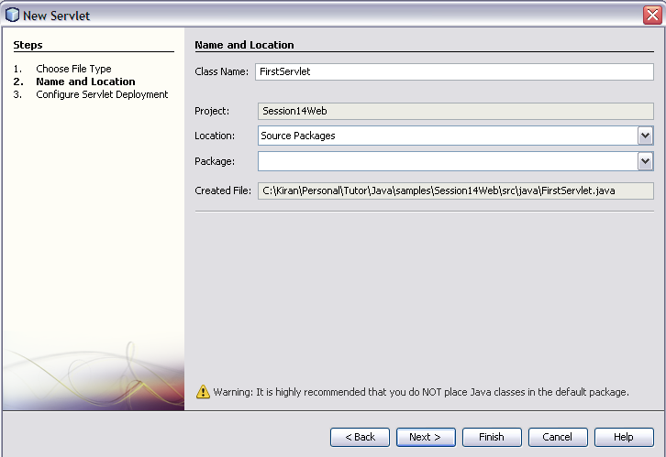
Creating our first Web Application
Give the name of the class is FirstServlet and say Next

Slide 15
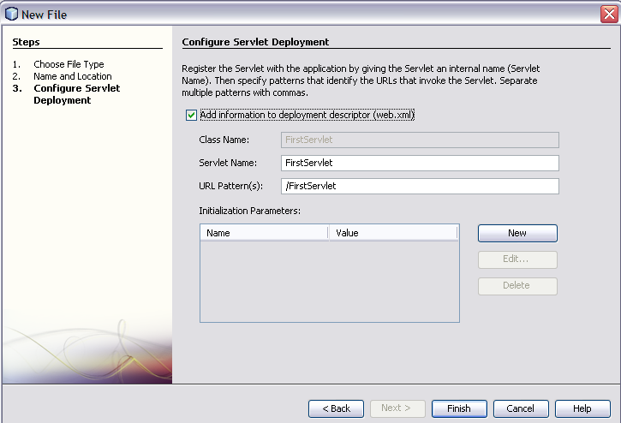
Creating our first Web Application

Slide 16
Creating our first Web Application
In the above slide if we observe you can find the below properties.
  Servlet Name : FirstServlet
  URL-Pattern : /FirstServlet
These above parameters will be automatically appended to the web.xml file
Now click on Finish.

Slide 17

Questions??

